Slide 1

W. P. Carey Presentation Title
Subhead text can go here

Slide 2
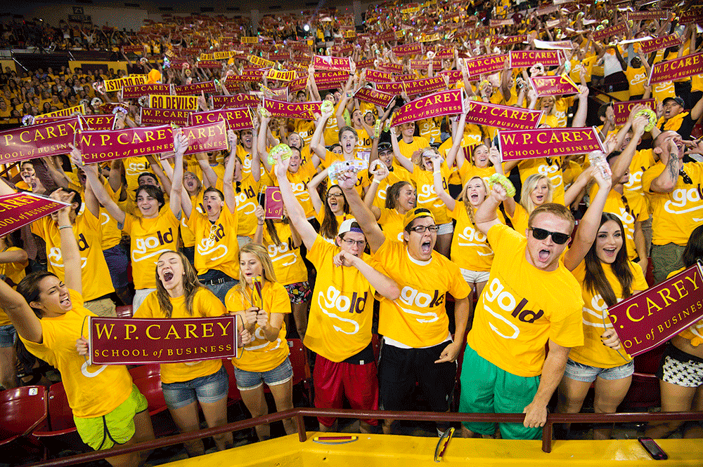

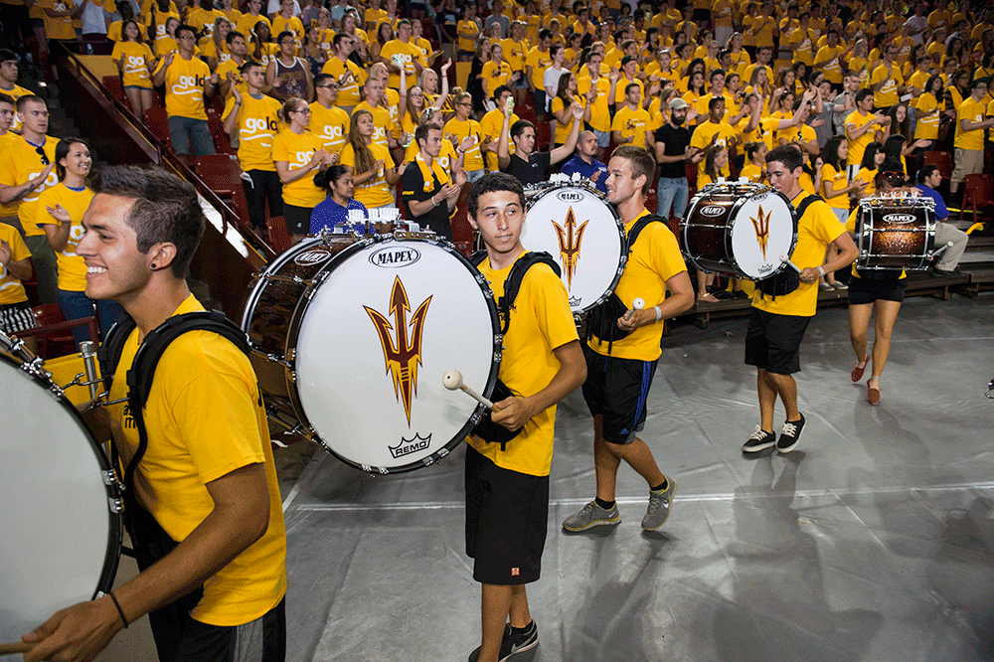
program slide header here
First Level
Second level
Second level
Second level
– Third level

Slide 3


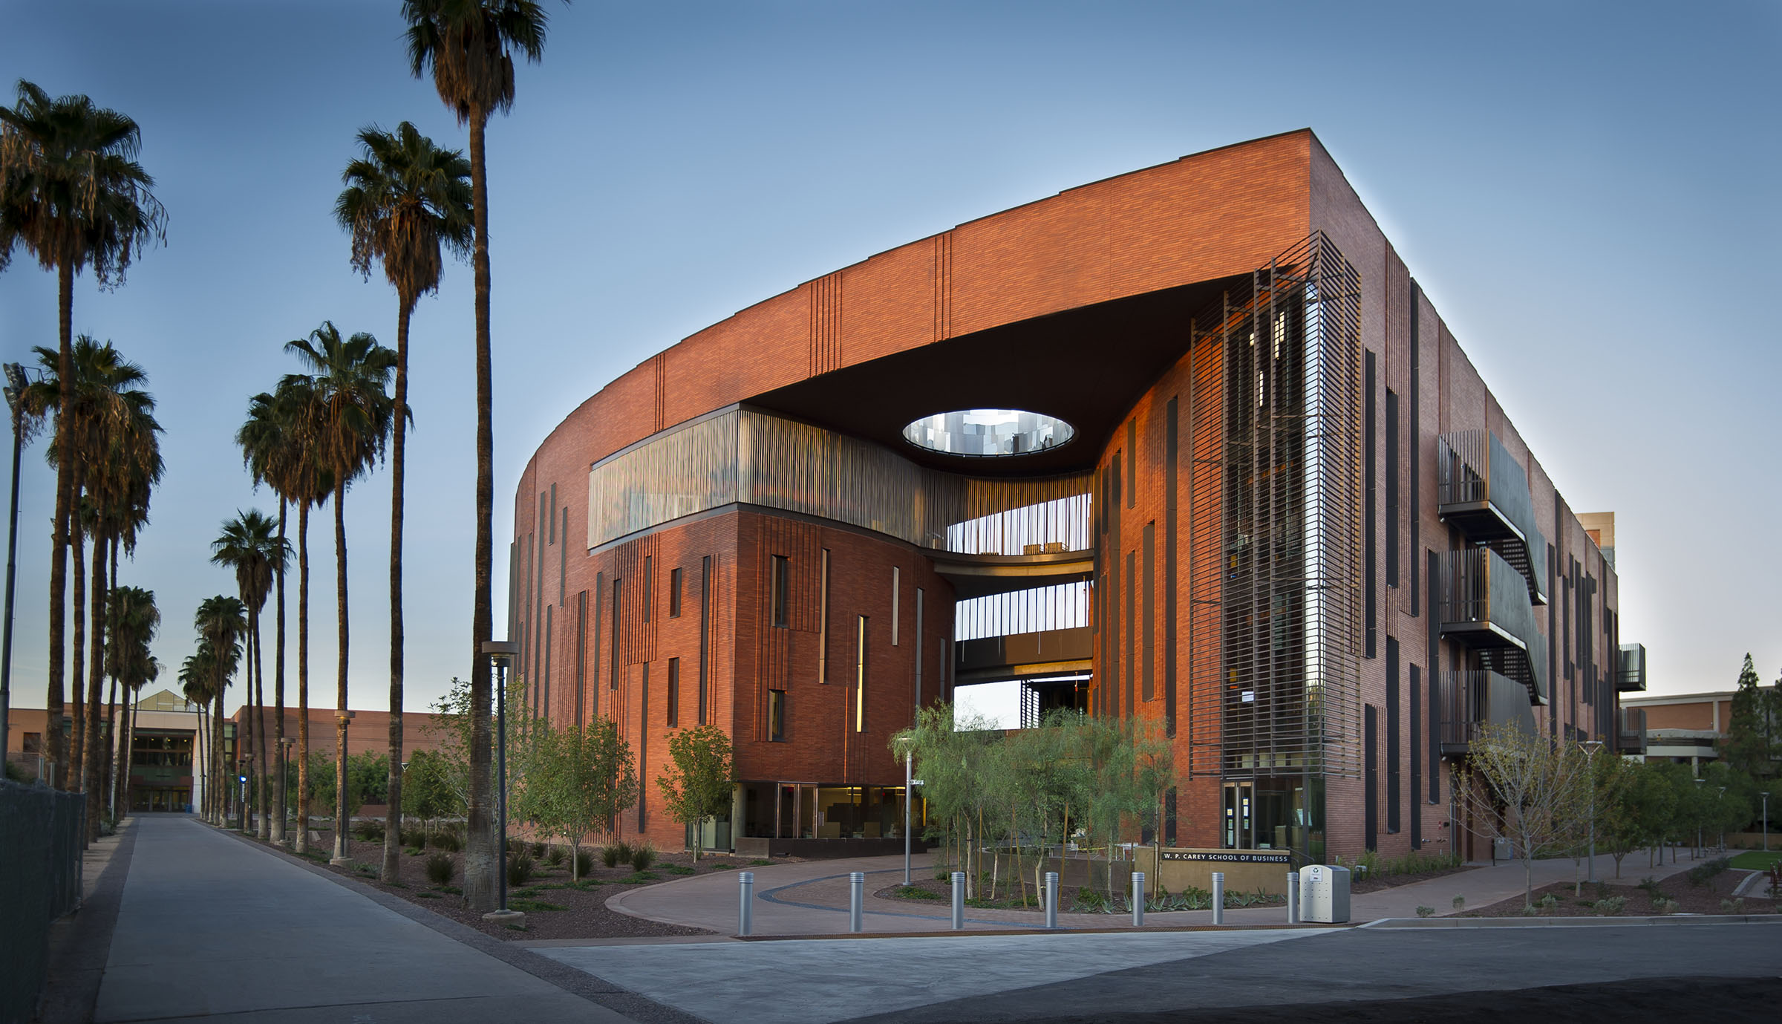
program slide header here
First Level
Second level
Second level
Second level
– Third level
– Third level
– Third level

Slide 4
program slide header here
2011
Timeline detail content
2012
Timeline detail content
2013
Timeline detail content
2014
Timeline detail content

Slide 5
program slide header here
First Level
Second level
Second level
Second level
– Third level
– Third level
– Third level

Slide 6
program slide header here
First Level
Second level
Second level
Second level
– Third level
First Level
Second level
Second level
Second level
– Third level

Slide 7
program slide header here
Heading Here
Content here
Content here
Content here
Content here
Content here
Content here
Write body content here.

